Slide 1
Exercise Physiology Respiratory changes in exercise
Dr Tania Warnakulasuriya

Slide 2
During exercise
Energy and oxygen requirement increases- need more energy and oxygen
Carbon dioxide and heat production increases- need to remove CO₂ and heat

Slide 3
Classification of exercise
Isotonic
muscle tone remains the same
but muscle length reduces
(dynamic/ aerobic/ cardiovascular exercise)
walking
running
swimming
cycling
dancing
skipping
Isometric
muscle length remains the same
but muscle tone increases
(static, weight or resistance exercise)
weight-lifting
athletic throwing events
rock-climbing

Slide 4
Classification of exercise
Mild – Moderate
occurs below anaerobic/ lactate threshold
lactic acid is not elevated
Heavy
above anaerobic threshold
initially lactic acid increases and them remains constant - steady state
Severe
above anaerobic threshold
lactic acid continues to rise - unsteady state

Slide 5
At rest and under steady-state exercise conditions, there is a balance between blood lactate production and blood lactate removal
The anaerobic/ lactate threshold refers to the intensity of exercise at which there is an abrupt increase in blood lactate levels
It could be due to
1) Decreased lactate removal 2) Increased fast-twitch motor unit recruitment 3) Imbalance between glycolysis and mitochondrial respiration

Slide 6
More about the Anaerobic Threshold (AT)
Anaerobic metabolism kicks in when exercise intensity is greatly increased
The aerobic system can no longer keep up with the body’s energy demand
The anaerobic threshold occurs when.
The amount of lactate produced through glycogenolysis and glycolysis
>> the utilization and oxidation of lactate
The anaerobic threshold (lactate threshold) represents the point at which blood lactate begins to rise above baseline levels during exercise

Slide 7
What happens when AT is exceeded?
Muscle pain, burning and fatigue make anaerobic energy expenditure difficult to sustain for longer than a few minutes
As lactate levels rise there is an associated increase in hydrogen ions. Excess hydrogen ions reduces cellular pH, causing interference with cellular enzymic activity and metabolism and leads to fatigue
Lactate helps to preserve force production and is an important source of fuel that can be oxidized within aerobic metabolism or converted to pyruvate or glucose

Slide 8
Respiratory changes in exercise occur
To obtain more O₂ and to remove excess CO₂ | Increase in minute ventilation (TV x rr) increase diffusing capacity/ gas exchange
To release more oxygen to the tissues | Shift of the oxygen haemoglobin dissociation curve to the right

Slide 9
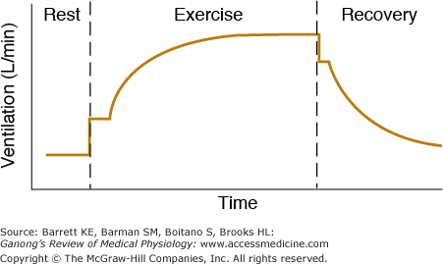
Increase in ventilation
Abrupt increase- neural mechanisms
Psychic stimuli and proprioceptors
Gradual increase- humoral factors
Plateau-
Small rapid drop after cessation of exercise
Gradual recovery

Slide 10
Factors increasing ventilation
Moderate exercise
pH, PO₂, and PCO₂ remain constant during moderate exercise
↑ body temperature
↑ plasma K⁺ level
↑ sensitivity of neurons controlling response to CO₂ – even though normal PaCO₂ levels
PaO₂ may play a role – even though this remains normal
Both depth and rate of respiration increase but increase in depth is more.

Slide 11
Factors increasing ventilation
Vigorous exercise
Increased lactic acid, buffering produces more CO₂
H⁺
Both depth and rate of respiration increase equally.
P_{A}O₂ ↑, ↓P_{A}CO₂ and PaCO₂
compensates the metabolic acidosis

Slide 12
At alveolar level
Venous PO₂ following exercise is around 25mmHg ( Vs 40mmHg)
Alveolar capillary O₂ gradient increases
More blood enters the pulmonary circulation (4-5 times increase in cardiac output)
Opening of previously closed pulmonary capillaries (capillary bed dilation)
Mean distance for diffusion is greatly decreased
Surface area for diffusion is increased
Diffusing capacity is increased
More O₂ enters blood

Slide 13
Pulmonary Ventilation
Normal ventilation (RMV) 6L/min
At maximal exercise 100 – 110 L/min
Maximal breathing capacity 150 – 170 L/min
Provides the ability to compensate when,
exercising at high altitude
exercising in very hot environment
Respiratory system diseases
CO₂ excretion increase from 200mL/min to 8000mL/min
Notes:
RMV- Respiratory minute volume

Slide 14
At tissue level
In active tissues, more O₂ is extracted from blood and used.
PO₂ falls nearly to zero in tissue and venous blood from active muscles.
This reduces the venous PO₂ (from 40 to 25mmHg).
Dilated capillary bed in active muscles- reduce the distance for diffusion of O₂
Oxygen haemoglobin dissociation curve shifts to the right due to,
↓ pH
↑ temp
↑ 2,3 BPG in red cells

Slide 15
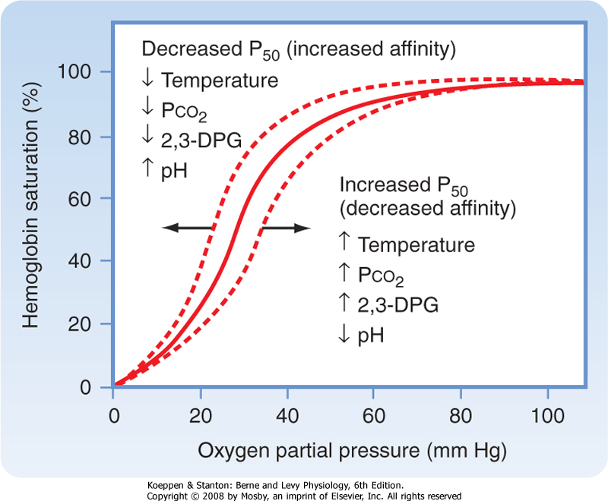
O₂ – Hb dissociation curve
At PaO₂ range 20-60 mmHg the curve is steep
More release of O₂ with reduction of 1mmHg of PaO₂
3 times more oxygen released to muscle

Slide 16
O₂ consumption during exercise
Normal O2 consumption (at rest) 250 ml/min
During exercise
Untrained average male 3600 ml/min
Trained average male (athlete) 4000 ml/min
Male marathon runner 5100 ml/min

Slide 17
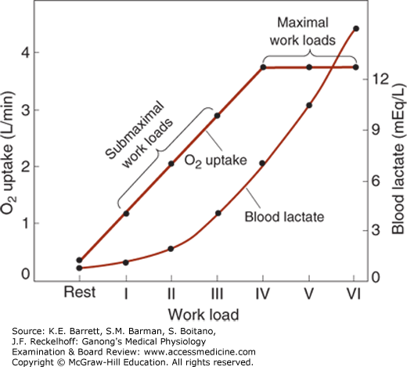
O₂ uptake
Increase in O₂ uptake is proportional to the workload up to a maximum
Above the maximum, the O₂ uptake plateaus
Blood lactate rise
(anaerobic metabolism)

Slide 18
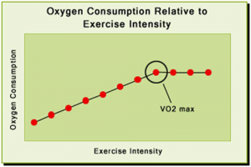
VO₂ max
VO₂ max- Maximum amount of oxygen consumed under maximal aerobic metabolism.

Slide 19
VO₂ _{max}
Reflects the aerobic physical fitness of an individual
Low in sedentary people
Increases with training
Limited by the rate at which oxygen is transported to the mitochondria in the exercising muscle

Slide 20
Maximal oxygen consumption (VO₂ _{max}) quantifies a person’s capacity for aerobic resynthesis of ATP
After reaching VO₂ _{max} , additional work can only be done by anaerobic metabolism
Blood lactate continues to rises
The person becomes exhausted and stops exercising
At this point an oxygen debt is being created

Slide 21
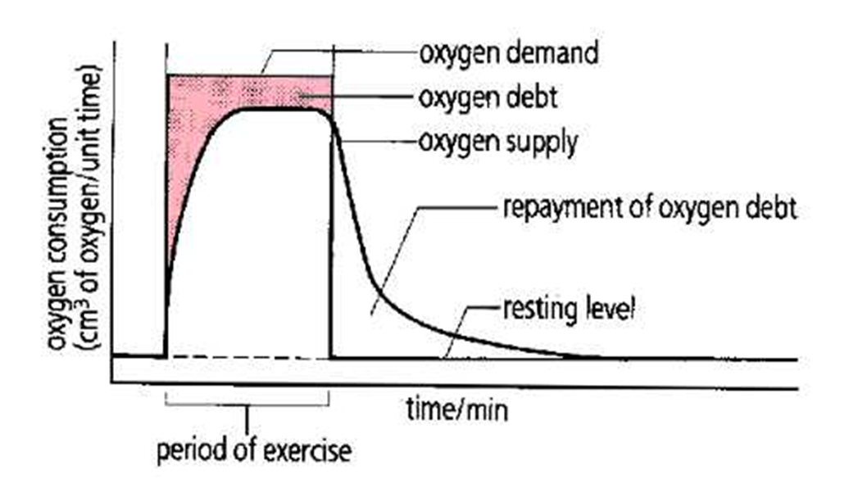
O₂ debt
Difference between total work and aerobic work.
(= anaerobic work)
O₂ debt will,
Replace stored O₂ - ~2L
Replace ATP
Removal of lactate
(80% converted to glycogen)
The respiratory rate does not reach basal levels until O₂ debt is repaid. High H⁺ due to lactic acidosis is the cause.(Takes up to 90 minutes)

Slide 22
O₂ consumption during exercise
Oxygen Debt (11.5 L)
a) 2 L (stored O₂)
b) 9.5 L (metabolic recovery)
STORED OXYGEN (2 L)
0.5 L - air in the lungs
0.25 L - dissolved in the body fluids
1 L - combined with haemoglobin
0.3 L - combined with myoglobin

Slide 23
Fatigue
Due to
Increased stimulation of the brain due to impulses from joints and muscles
Acidosis
Dyspnea
Activation of J receptors
Rise in body temperature
Hypoglycemia
Muscle glycogen depletion
Accumulation of metabolites in muscle

Slide 24
Isocapnic buffering
Increase in ventilation and increase in CO₂ production balance out
P_{A}CO₂ and PaCO₂ change only slightly

Slide 25
Effects of training on respiratory system
Increased strength of respiratory muscles
Higher diffusing capacity
Increased metabolism of lactic acid

Slide 26
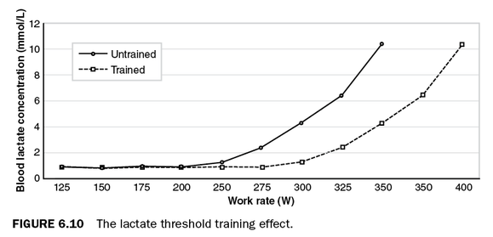
Lactate threshold with increasing work rate

Slide 27
Summery- Respiratory compensation in exercise
The venous PO₂ reduce from 40mmHg to 25mmHg
Lung alveolar capillary O₂ gradient increase
More O₂ enters blood
More blood enters the pulmonary circulation (Increased cardiac output and pulmonary capillaries recruitment)
In active tissues more O₂ is extracted from blood.

Slide 28
After exercise
In heavy exercise the respiratory rate takes a long time to return to normal.
Respiratory rate does not reach basal level until O₂ debt is repaired.
High H+ due to lactic acidosis is the cause.
(Takes up to 90 minutes)

Slide 29
Interesting facts
A reduction in the oxygen carrying capacity in conditions such as anaemia produces fatigue and shortness of breath on mild exertion.
Blood doping- Some athletes have tried to increase red blood cell levels by removing, storing and then reinfusing them. This method has been shown to improve VO2max by up to 10%.
More recently, Erythropoietin abuse in sport in order to increase red blood cell levels has come up.
The improvements in VO2max observed when employing these methods provide good evidence that oxygen delivery is a limiting factor for VO2max

Slide 30
Cardiovascular changes in exercise
Increased cardiac output
Changes in blood pressure
Increased pulmonary blood flow
Increased muscle blood flow to the active muscles
Reduced flow to certain organs

Slide 31
Cardiovascular changes in exercise
Start immediately before exercise
? Psychic stimuli
? Stimulation of muscle & tendon stretch receptors and muscle chemoreceptors
Due to
Reduced vagal output to the heart
Increased sympathetic output

Slide 32
1. Increase in cardiac output
Inotropic and chronotropic effects ↑
↑heart rate
↑stroke volume - ↑contractility > ↑ venous return
↑cardiac output (CO)
In an untrained person CO increased up to 4 times of resting (5L/min →20L/min)
In a trained athlete up to 6 times (5L/min → 30L/min)

Slide 33
Increase in venous return during exercise
↑ muscle pump activity
↑ thoracic pump activity
Redistribution of blood by viscera (splanchnic and other areas vasoconstriction)
Increased pressure transmitted from dilated arterioles to veins
Venoconstriction

Slide 34
Redistribution of blood from other organs
Splanchnic, renal and inactive muscle vasoconstriction
Cerebral blood flow remains constant
Coronary blood flow increases due to local regulation
Increases during diastole and drops during systole
Cutaneous blood flow increases later due to increase in body temperature

Slide 35
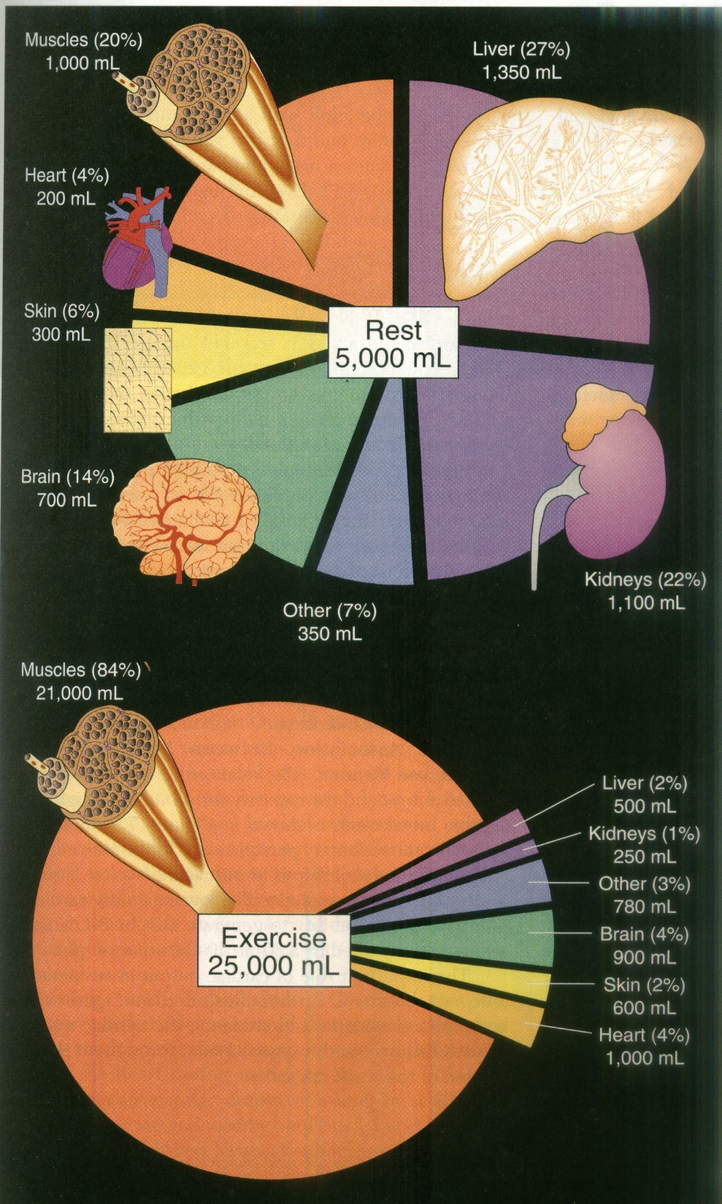

Slide 36
In severe exercise
Heart rate increases above maximum heart rate
Stroke volume decreases; as diastole is shortened

Slide 37
What happens during isometric exercise?
Heart rate increases at the start
Stroke volume remains relatively unchanged
Total peripheral resistance is increased
Both SBP and DBP increase sharply

Slide 38
What happens during isotonic exercise?
HR increases
Marked increase in stroke volume
Net decrease in total peripheral resistance
SBP increases moderately
DBP remains steady or even falls

Slide 39
2. Change in blood pressure
ISOTONIC EXERCISE
Systolic blood pressure ↑
Diastolic blood pressure ↓ or no change
Pulse pressure widens
Mean blood pressure ↑
ISOMETRIC EXERCISE
Systolic blood pressure ↑
Diastolic blood pressure ↑
Mean blood pressure ↑similar to above

Slide 40
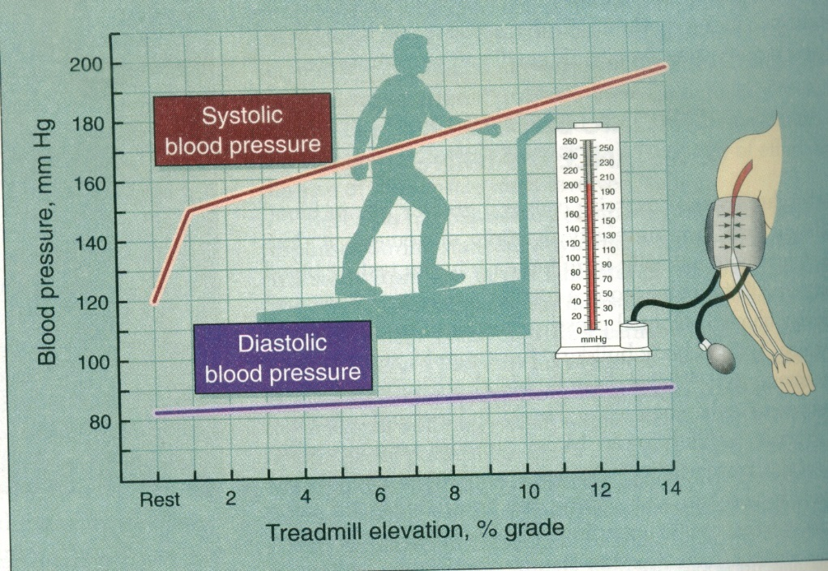
Change in blood pressure during isotonic exercise
↑ CO
PULSE PRESSURE

Slide 41
More about blood pressure
Remains increased during exercise
May drop low immediately after exercise as vessels remain dilated due to accumulated metabolites
Important to ‘cool down’
Returns to pre-exercise levels sooner than the heart rate

Slide 42
3. Increased pulmonary blood flow
Increased cardiac output
Pulmonary capillaries are recruited

Slide 43
4. Increased muscle blood flow
In resting muscle
* blood flow is low
* 2-4mL/100g/min
In resting muscles, most pre-capillary sphincters are closed
In exercising muscles, arterioles dilate and pre-capillary sphincters open up increasing the surface area of the capillary bed

Slide 44
Dilation of arterioles and precapillary sphincters
Initially by neural mechanisms (sympathetic vasodilator system)
Later maintained by local regulation

Slide 45
Local mechanisms maintaining muscle blood flow
↓ tissue PO₂
↑ tissue PCO₂
accumulation of K⁺
other vasodilator metabolites
↑ temperature
accumulation of H⁺ ions in severe exercise due to lactic acid production

Slide 46
What happens when arterioles dilate and precapillary sphincters open up?
Increases the number of open capillaries
Increases cross sectional area
slows down the velocity of blood flow in capillaries
more area available for diffusion
Reduce the distance for diffusion
Increases hydrostatic pressure in capillaries and increases fluid transudation in to interstitial space
Increases lymph flow

Slide 47
When a muscle is contracted its blood flow is ↓
when muscle tension is >10% of maximum, the flow starts to drop
when muscle tension is >70% of maximum, flow completely stops
But
in between contractions the muscle blood flow per unit of time is ↑ up to 30 fold

Slide 48
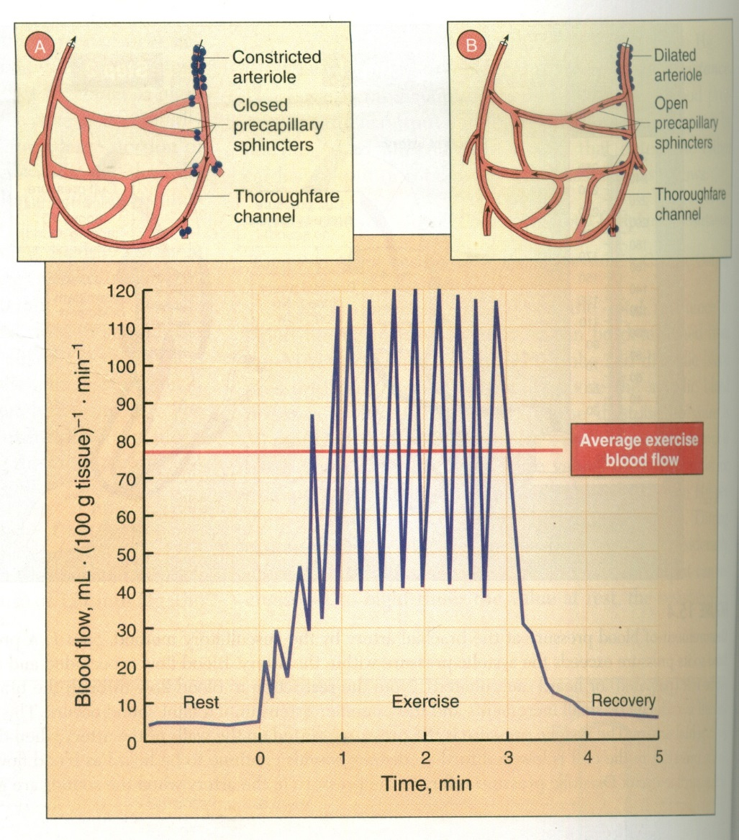

Slide 49
Let’s summarize the CVS changes during isometric and isotonic contractions
 | Isometric | Isotonic
HR | ↑ | ↑
Systolic BP | ↑ ↑ | Moderate ↑
Diastolic BP | ↑ ↑ | ↓ →
TPR | ↑ | ↓
Stroke volume | Slight change → | ↑↑
Muscle blood flow | ↓ | ↑ ↑

Slide 50
Maximum Heart Rate
220-age(in years)
214-(0.8 x age) for men, and 209-(0.9 x age) for women
Heart rate reserve
MHR – Resting Heart Rate (RHR)
To determine your RHR, take your pulse rate first thing in the morning, before engaging in any significant activity (ideally, before you get out of bed)

Slide 51
Research has shown that the anaerobic threshold occurs at
at 80-90% of heart rate reserve (HRR) in trained individuals
at 50-60% HRR in untrained individuals
between 85% and 90% of the HR_{max}

Slide 52
What is target heart rate?
You gain the most benefits and lessen the risks when you exercise in your target heart rate zone.
Usually this is when your exercise heart rate (pulse) is 60 to 80 percent of your maximum heart rate.
It is not recommended to exercise above 85 percent of your maximum heart rate.
When beginning an exercise program, you may need to gradually build up to a level that is within your target heart rate zone, especially if you have not exercised regularly before. If the exercise feels too hard, slow down.
To find out if your are exercising in your target zone, (between 60 and 80 percent of your maximum heart rate), stop exercising and check your 10-second pulse.
If your pulse is below your target zone, increase your rate of exercise. If your pulse is above your target zone, decrease your rate of exercise.

Slide 53
Target Heart Rate Zones by Age
Age | Target HR: | Max. HR:
20 | 120 – 170 | 200
25 | 117 – 166 | 195
30 | 114 – 162 | 190
35 | 111 – 157 | 185
40 | 108 – 153 | 180
45 | 105 – 149 | 175
50 | 102 – 145 | 170
55 | 99 – 140 | 165
60 | 96 – 136 | 160
65 | 93 – 132 | 155
70 | 90 – 123 | 150

Slide 54
In summary
Increased cardiac output
Changes in blood pressure
Increased pulmonary blood flow
Increased muscle blood flow to the active muscles
Reduced flow to certain organs

Slide 55
References
Respiratory Physiology the essentials, 9th edition by Jhon B West.
Guyton and Hall textbook of Medical Physiology, 12th edition
Gannong’s review of Medical Physiology,25th edition
Deborah Anne Burton, Keith Stokes, George M Hall; Physiological effects of exercise, Continuing Education in Anaesthesia Critical Care & Pain, Volume 4, Issue 6, 1 December 2004, Pages 185–188, https://doi.org/10.1093/bjaceaccp/mkh050

Slide 56

EXERCISE

